Slide 1
Life as an Apache Hadoop Committer
(Or, how to run an open source business)
Wei-Chiu Chuang
01/19/2017

Slide 2






Bio
NCTU-CS (formerly NCTU-CIS)
DSO at DDG-1803 (紀德級左營號)
Purdue-CS
Cloudera / Apache Hadoop

Slide 3
Apache Software Foundation
An open source project governance organization
Hadoop, Hive, HBase, Spark …
Other OSPG organizations exist
Linux Foundation, Openstack Foundation, Eclipse Foundation, Mozilla Foundation, ...
Most “Big Data” projects are either sponsored by ASF or released under Apache License.
ASF sponsors infrastructures (mailing lists, bug report systems, code repositories)
ASF only involve in a project in very rare cases
https://projects.apache.org
Notes:
Apache Cassandra
With the notable exception of MongoDB

Slide 4
Apache Hadoop
One of the most well known Apache Software Foundation sponsored projects
The most well-known Big Data platform
Participants
Contributors
Committers
Project Committee Members (PMC)

Slide 5

Notes:
Hadoop cluster at Yahoo

Slide 6
Cloudera
Commercializes Hadoop* technology
Open source, open culture
I can work anywhere, anytime on Earth provided that I have internet connectivity.
CDH - Cloudera’s Distribution for Hadoop
Platform. Open source
Cloudera Manager (CM), Cloudera Navigator, Key Trustee
Cluster management, monitoring. Proprietary
*Hadoop and its associated projects
Notes:
Health care, telecom, retail, tech, media, government,

Slide 7
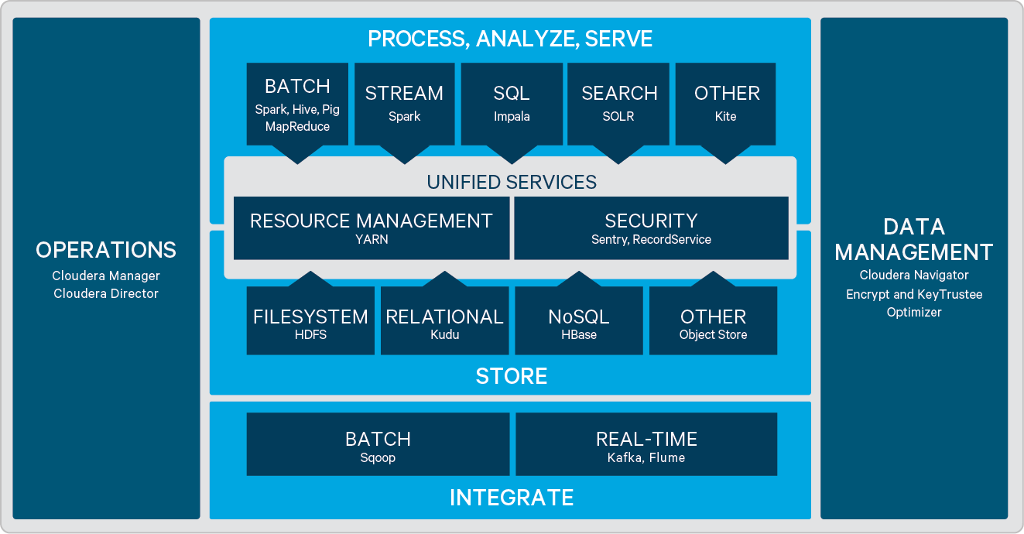

Slide 8
Open Source Innovation, Enterprise Grade Quality
Open source projects are fun and move fast
You want something? Just do it!
Thousands of contributors worldwide
Quality is critical
Hadoop is a billion dollar business
Customers trust us and pay us; but we must trust the code written by unknown 3rd party.
Integration with other components
Conflict of interests
How to balance open source innovation and quality?
Notes:
For example, CDH is composed of multiple components. But each component is developed separately. Therefore they do not have a common goal. For example, different components support different authentication mechanisms. The existence of a distribution is to reconcile the difference.

Slide 9
Cloudera’s approach
Regard Apache Software as reference implementation
Encourage more Clouderans to become committers in Apache projects
Make sure features and bug fixes get pushed into codebase in time.
Make sure Cloudera’s opinion is heard.
Double code review process
Make sure every line of code brought in is reviewed internally.
Internal integration test

Slide 10
Development Flow
Code review
Upstream bug report (JIRA)
Upstream patch
Upstream commit
Dev.
Unit test
Upstream
Code review
CDH
Cherrypick
integration
Build
Endurance test
Release
Smoke test/
Nightly test
Fault Injection

Slide 11
Cloudera’s approach to open source business
Open source is great
No vendor lock-in
Popular platform software is usually open source
Hadoop is hard
Large scale distributed systems
Hadoop alone has > 1,000 configurable properties
Anything that stores data, or computes data, is open source.
Anything that makes it easier to manage, deploy, diagnose is proprietary.
Hybrid Open Source Software Model
Notes:
Most new platform software is open source -- if you think the new thing will dominate/replace the old one, better brace it now.
HOSS model is also used by Confluence (Apache Kafka creator)
Other OSS business models exist: pure service subscription based (Red Hat, Hortonworks). SaaS (Databricks, GitHub, Docker), or generate revenue from services built on top of OSS projects (Facebook)
Hadoop: 2.14 million LOC; CDH: 10.5 million LOC

Slide 12
Open Source Software Developer
Fun
Contribution is directly visible
Freedom to do anything
Build resume
Build network

Slide 13
What makes a successful open source project?
More than code
Build a community
Collaborative
A good governance organization
Notes:
Community -- mailing list, jira, workshop, meetups
Collaborative -- no single organization controls code commit

Slide 14
Hadoop 3
Why should you care about? Isn’t Spark going to replace Hadoop?
Cloudera sees Spark as part of Hadoop ecosystem
Spark code depends on Hadoop and Hive
Spark can run as a YARN app, input/output from HDFS
So, Hadoop is relevant

